Slide 1
Answering Research Questions with
Big Data from a MOOC
Theodore W. Frick, Ph.D.
Professor Emeritus, Department of Instructional Systems Technology, School of Education, Indiana University Bloomington
Cesur Dagli, Ph.D.
Instructional and Graphics Designer, Midwest and Plains Equity Assistance Center:
Great Lakes Equity Center, School of Education, Indiana University-Purdue University Indianapolis
Rodney D. Myers, Ph.D.
Independent Scholar, Bloomington, Indiana
AECT Annual Convention
Jacksonville, FL
November 10, 2017

Slide 2
Overview

Slide 3
Value of MOOCs for Research
Disadvantages of typical past research on instructional effectiveness
  Small convenience samples
  Limited generalizability
  Lack of replication
Advantages of well-designed MOOCs
  MOOC: Massive, Open, Online Course
  Very large, representative samples
  Broad generalizability
  Relatively easy to replicate over time

Slide 4
Background of IPTAT: Indiana University Plagiarism Tutorials and Tests
Mini-MOOC available worldwide since 2002
Millions of student users over first 14 years
Major redesign in 2015, using First Principles of Instruction (Merrill, 2013)
Results in big data: During first 22 months since Jan., 2016, over
  29 million page views of interactive instruction
  347,000 registered users from 204 countries
  280,000 passed a Certification Test

Slide 5
Results from Dagli (2017) study of IPTAT
Undergraduate and advanced high school students
  Nearly 3 times as likely to pass their first Certification Test who reported successful prior completion of most tutorials (designed with First Principles of Instruction)
  Compared with those who passed their first Test who reported they did not complete most tutorials
Graduate students (master’s and doctoral level)
  Over 5 times as likely to pass their first Certification Test who reported successful prior completion of most tutorials
  Compared with those who passed their first Test who reported they did not complete most tutorials

Slide 6
Big data from IPTAT
Supports Merrill’s prediction that First Principles of Instruction promote student learning
Wide generalizability of findings
  86% of students from U.S.
  4% from China
  3% from Canada
  Remaining 7% from 201 other countries
Student level of education
  82% Undergrad and advanced HS
  18% Graduate (master’s/doctoral)

Slide 7
Background

Slide 8
Massive Open Online Courses (MOOCs)
Massive → Large number of participants (Anderson, 2013)
Open → Free and open (Downes, 2007; Hylén, 2006; Schaffert & Geser, 2008).
Online → The delivery of courses through the Internet (Anderson, 2013)
Courses → Different than traditional face-to-face and online courses (Wiley, 2012)

Slide 9
Mini-MOOCs
Mini-MOOCs
  “Tightly focused in terms of scope and aimed at specific skills that can be developed and testing using automated means available through the Internet” (Spector, 2014, p. 390)

Slide 10
IPTAT as a Mini-MOOC
IPTAT: Indiana University Plagiarism Tutorials and Tests
Massive: A large number of participants
Open: Anyone can take this tutorial
Online: Web-based tutorial with mastery tests
Not a course, per se—focused on how to recognize plagiarism, used as a learning resource by teachers and students worldwide

Slide 11
IPTAT Redesigned in 2015
Link:
https://www.indiana.edu/~academy/firstPrinciples/
Available: 2016 to present

Slide 12





IPTAT Redesigned with First Principles of Instruction
5. INTEGRATION
2. ACTIVATION
Watch Me!
Where Do I Start?
PROBLEM
Let Me Do The Whole Task!
4. APPLICATION
3.DEMONSTRATION
Let Me Do It!
Don’t Just Tell Me, Show Me!

Slide 13
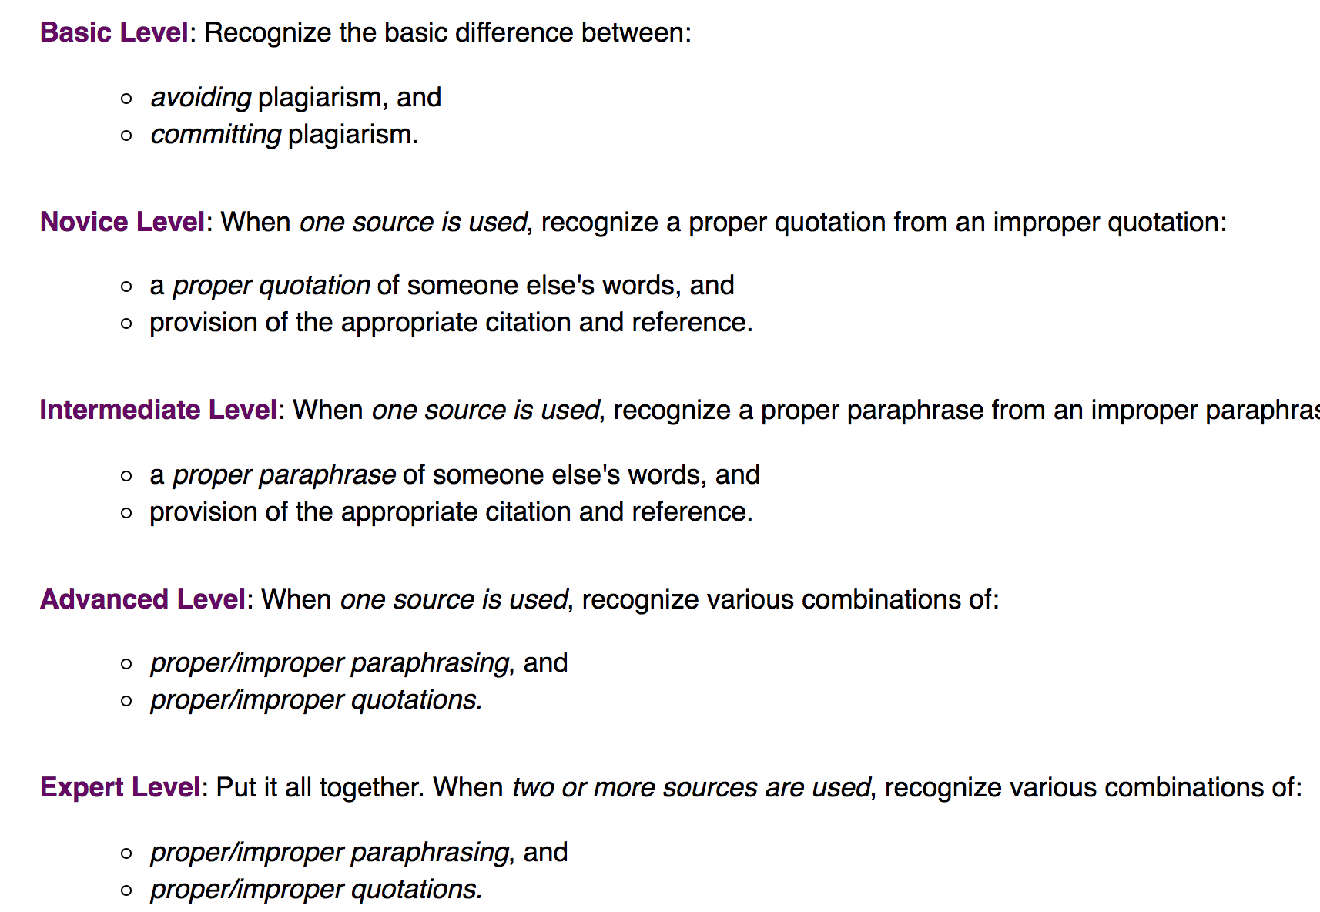
Simple to Complex Task Sequence

Slide 14
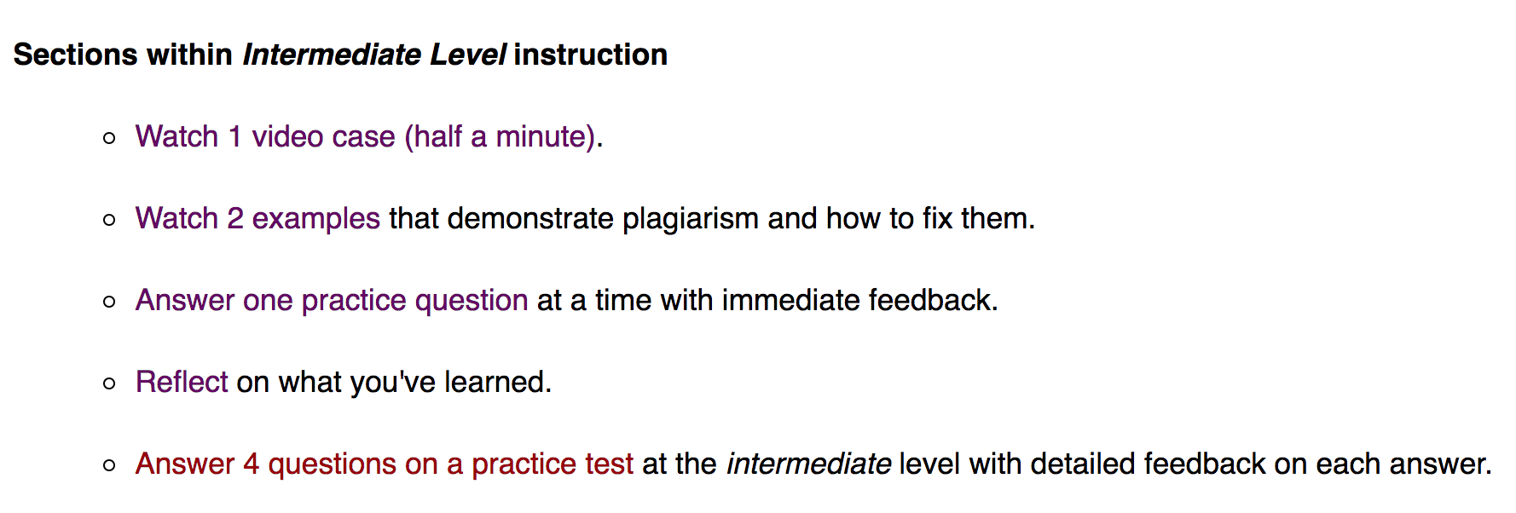
First Principles Implemented at Each Level of Task Complexity
For example:

Slide 15
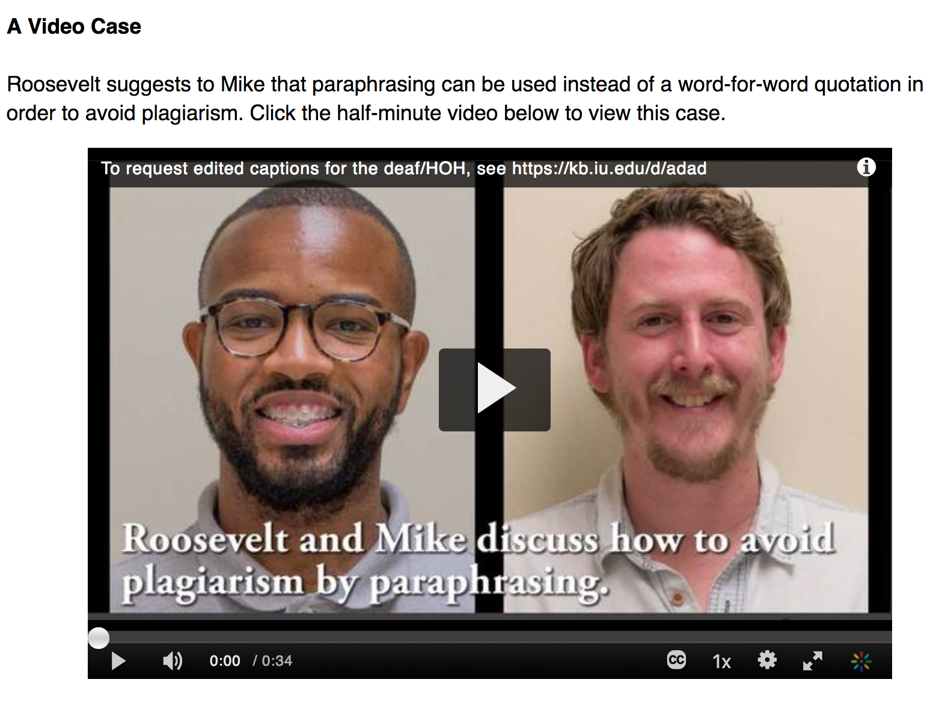
Activation Principle

Slide 16
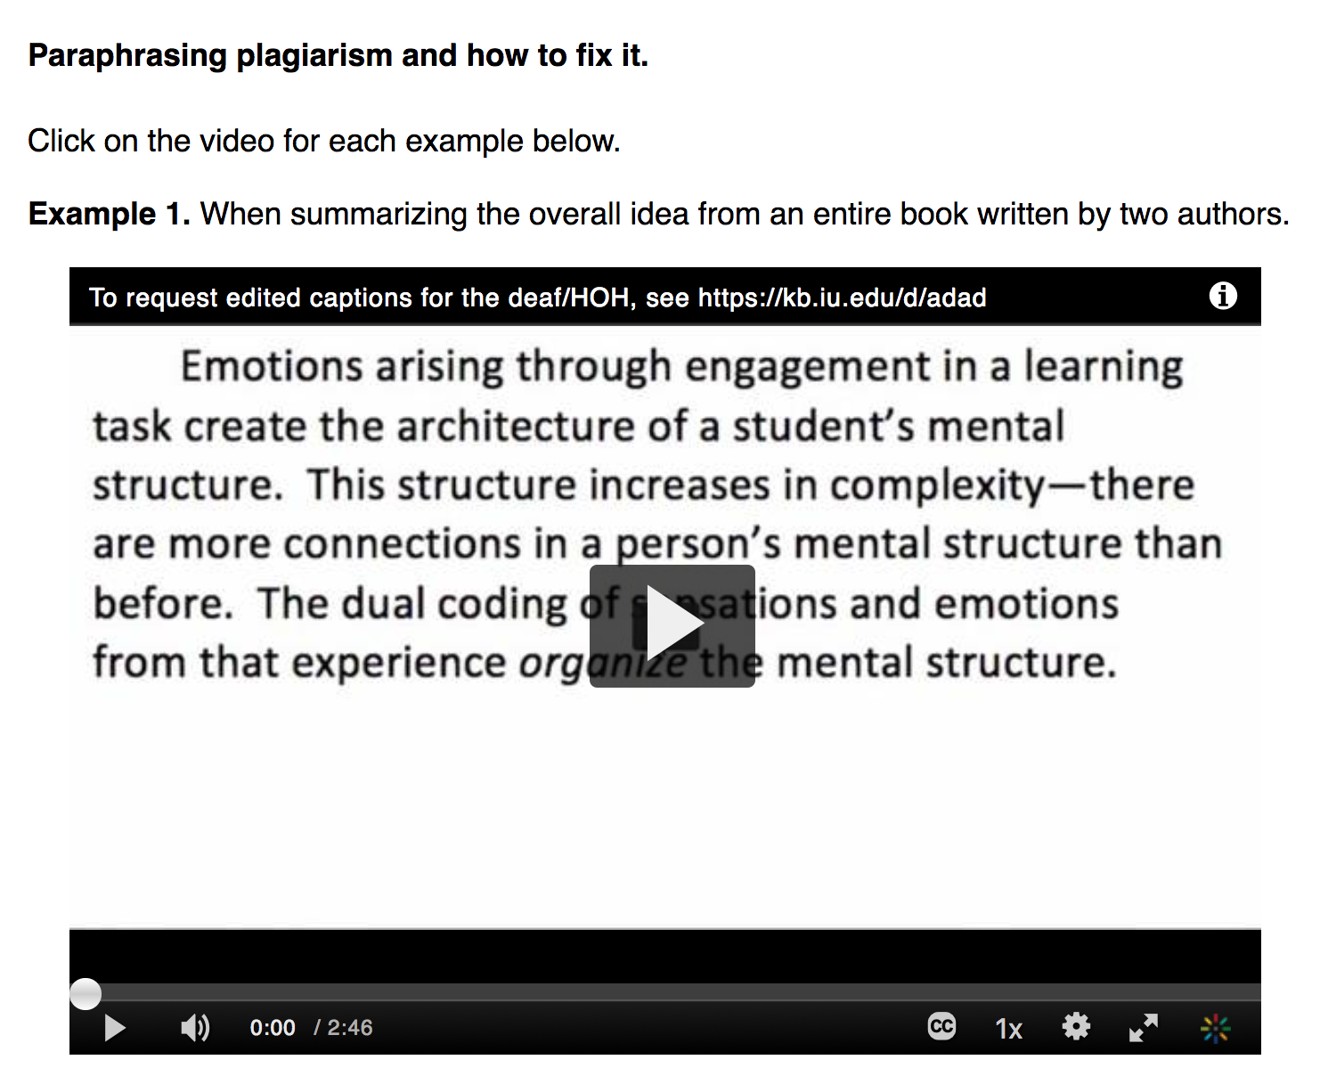
Demonstration Principle

Slide 17
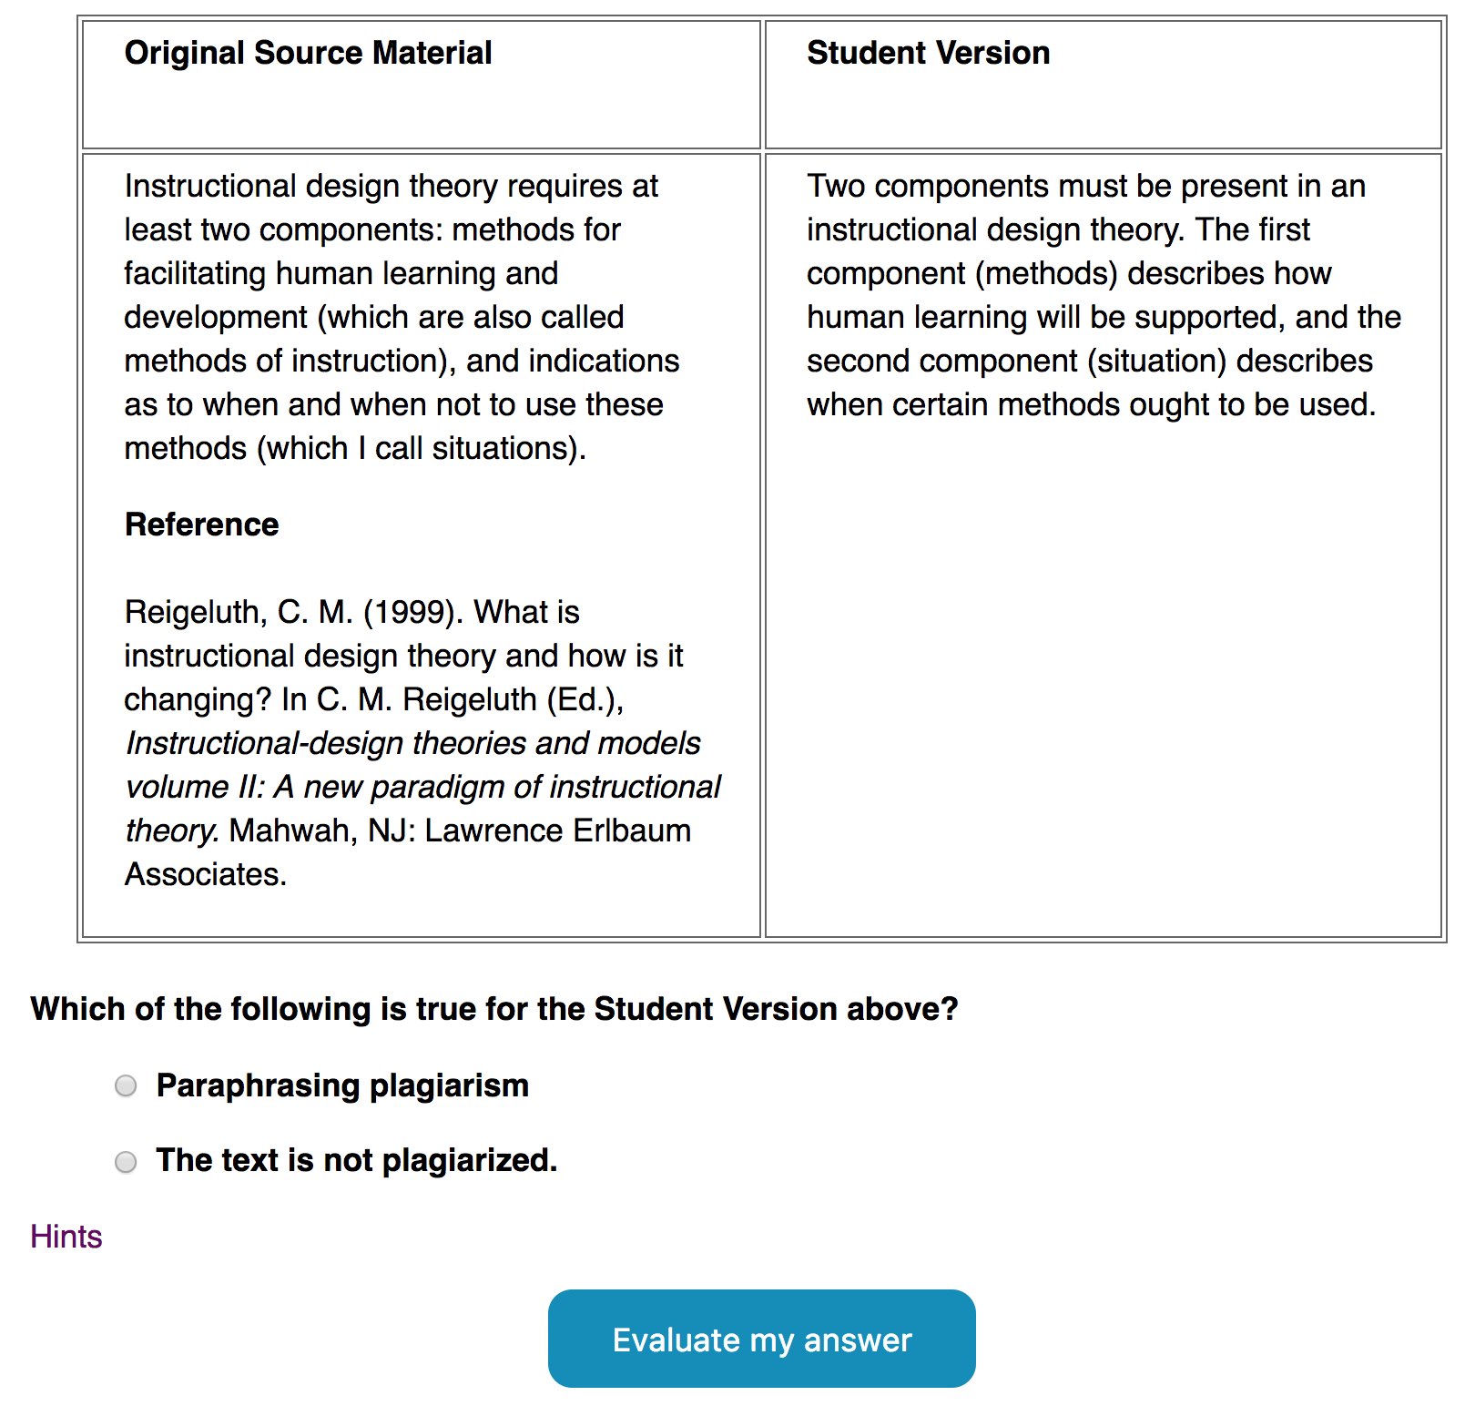
Application Principle

Slide 18
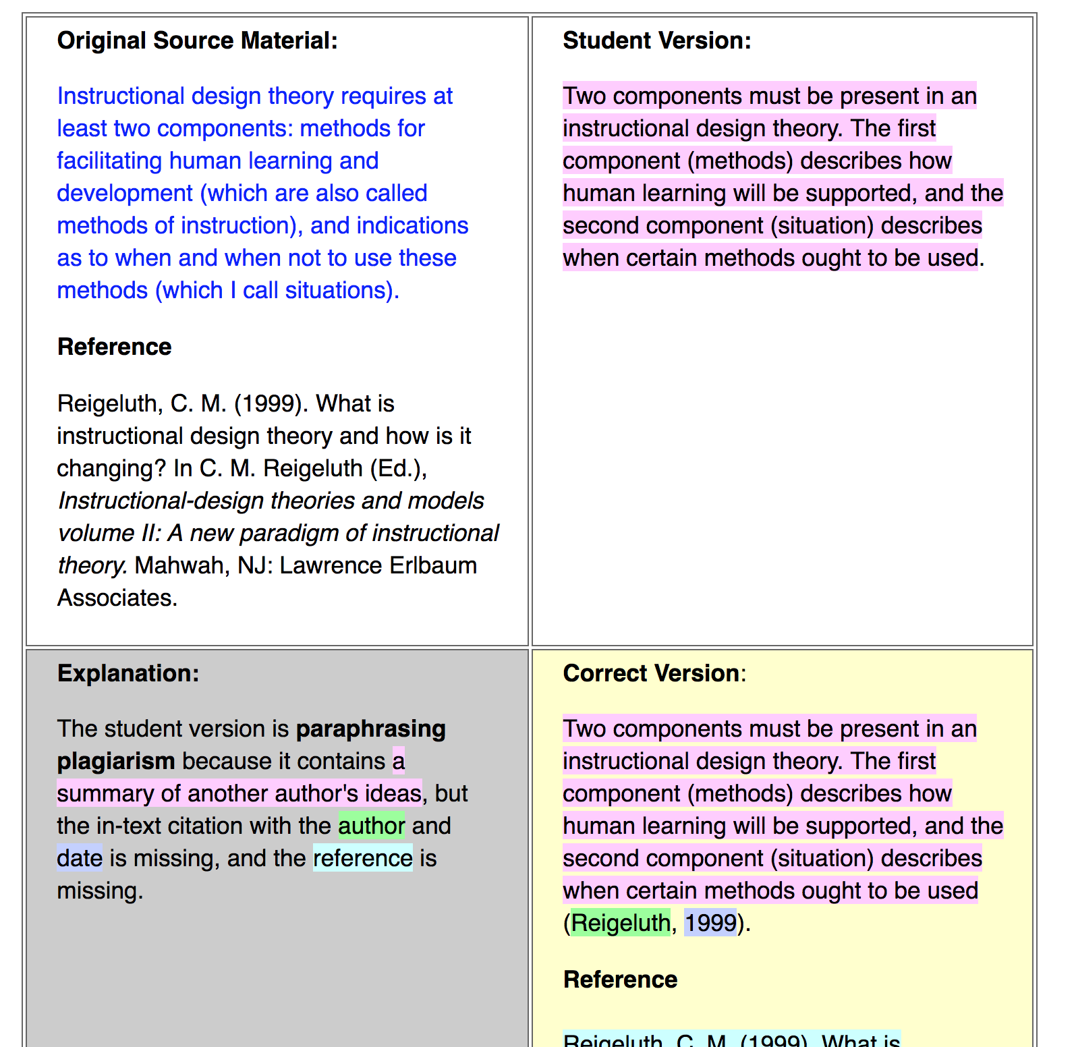
Application Principle (feedback)

Slide 19
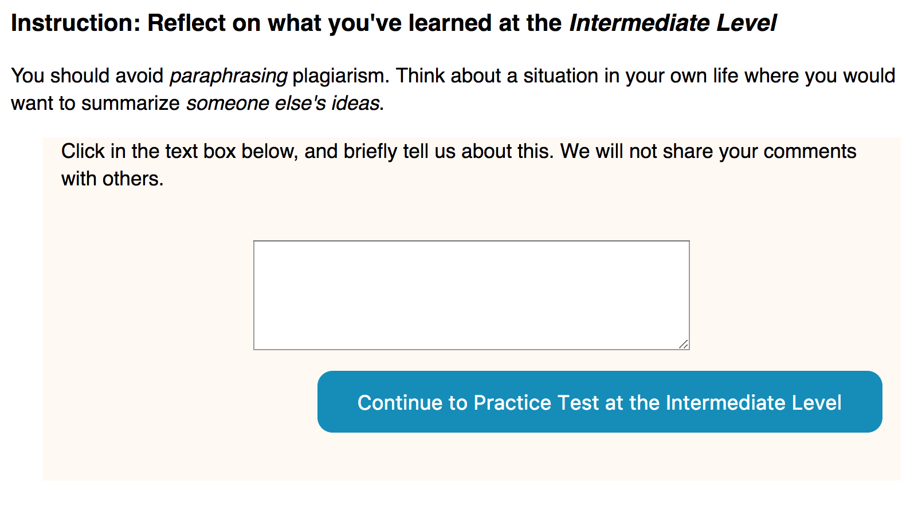
Integration Principle

Slide 20
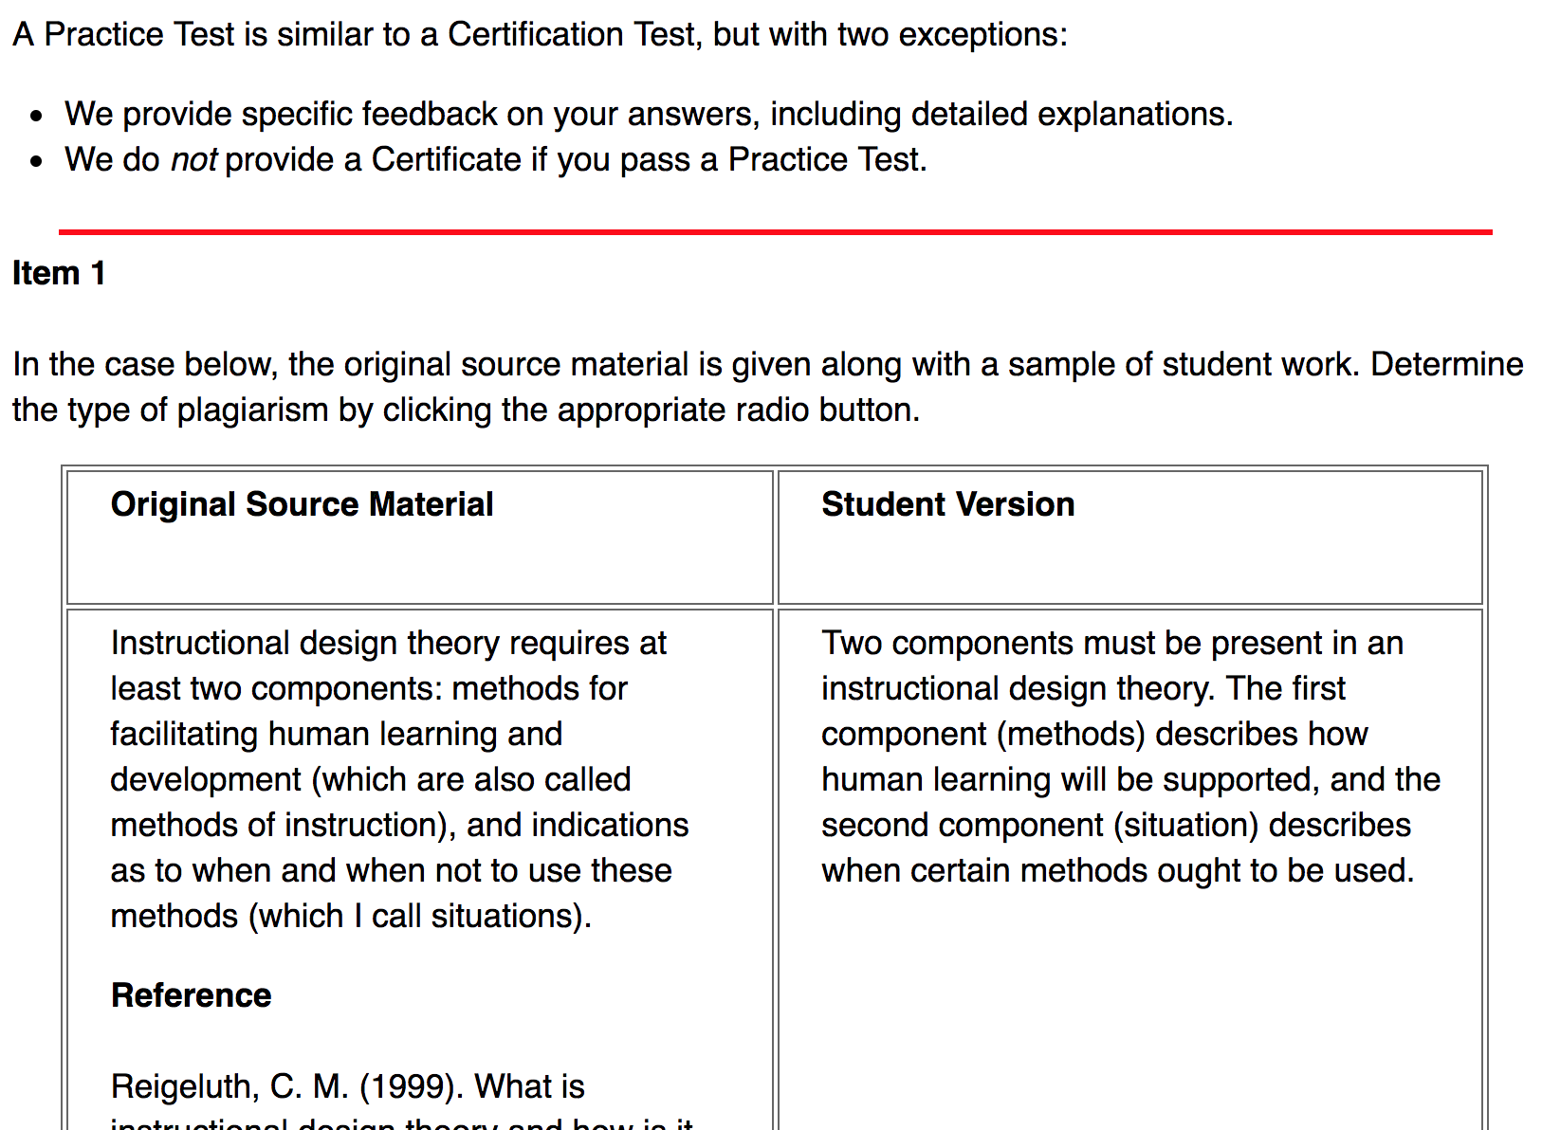
Practice Test (repeat Application)

Slide 21
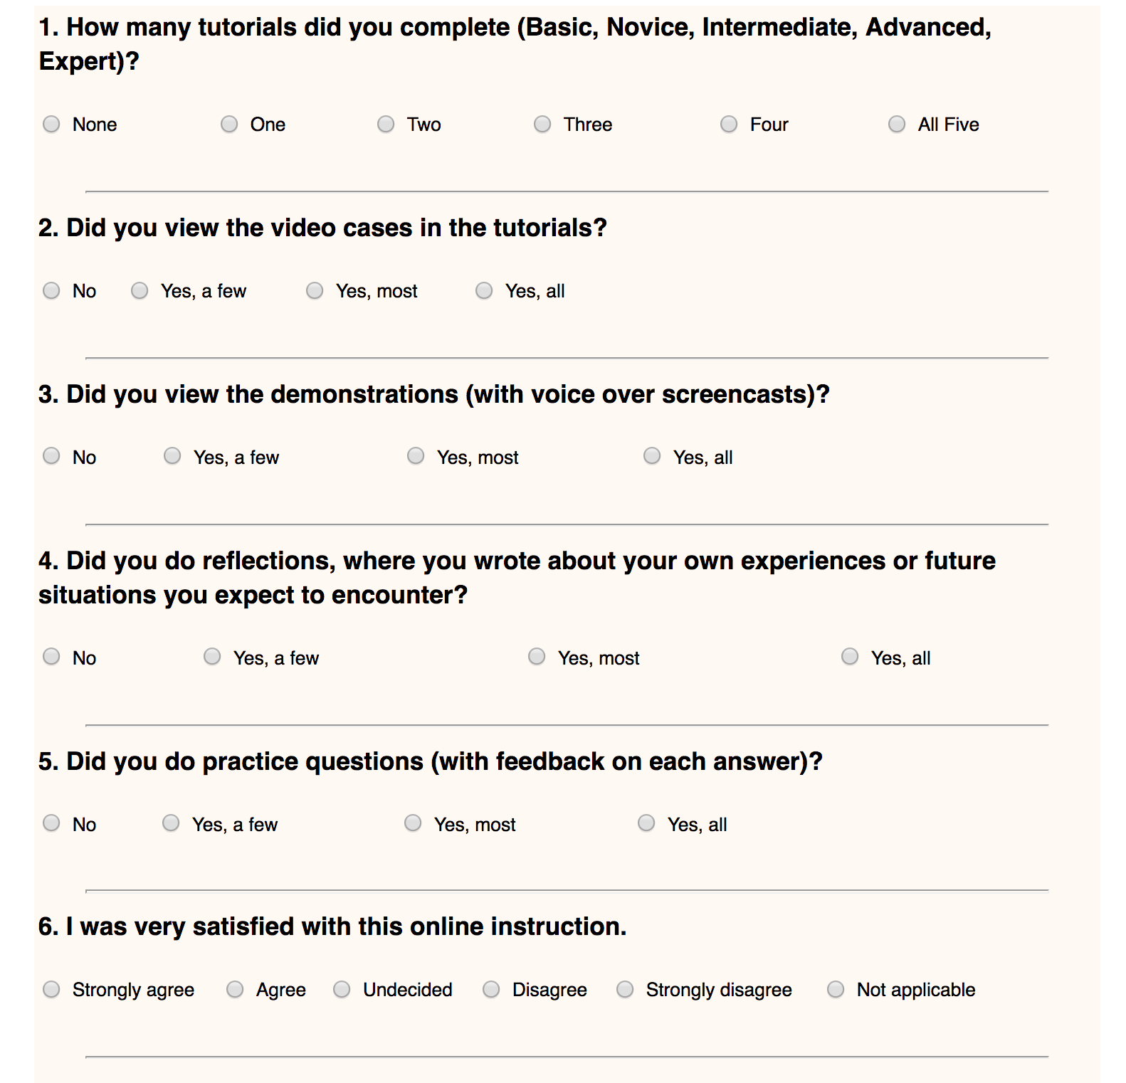
Evaluation of Instruction: 30 items-- optional before taking a test (MOO-TALQ)

Slide 22
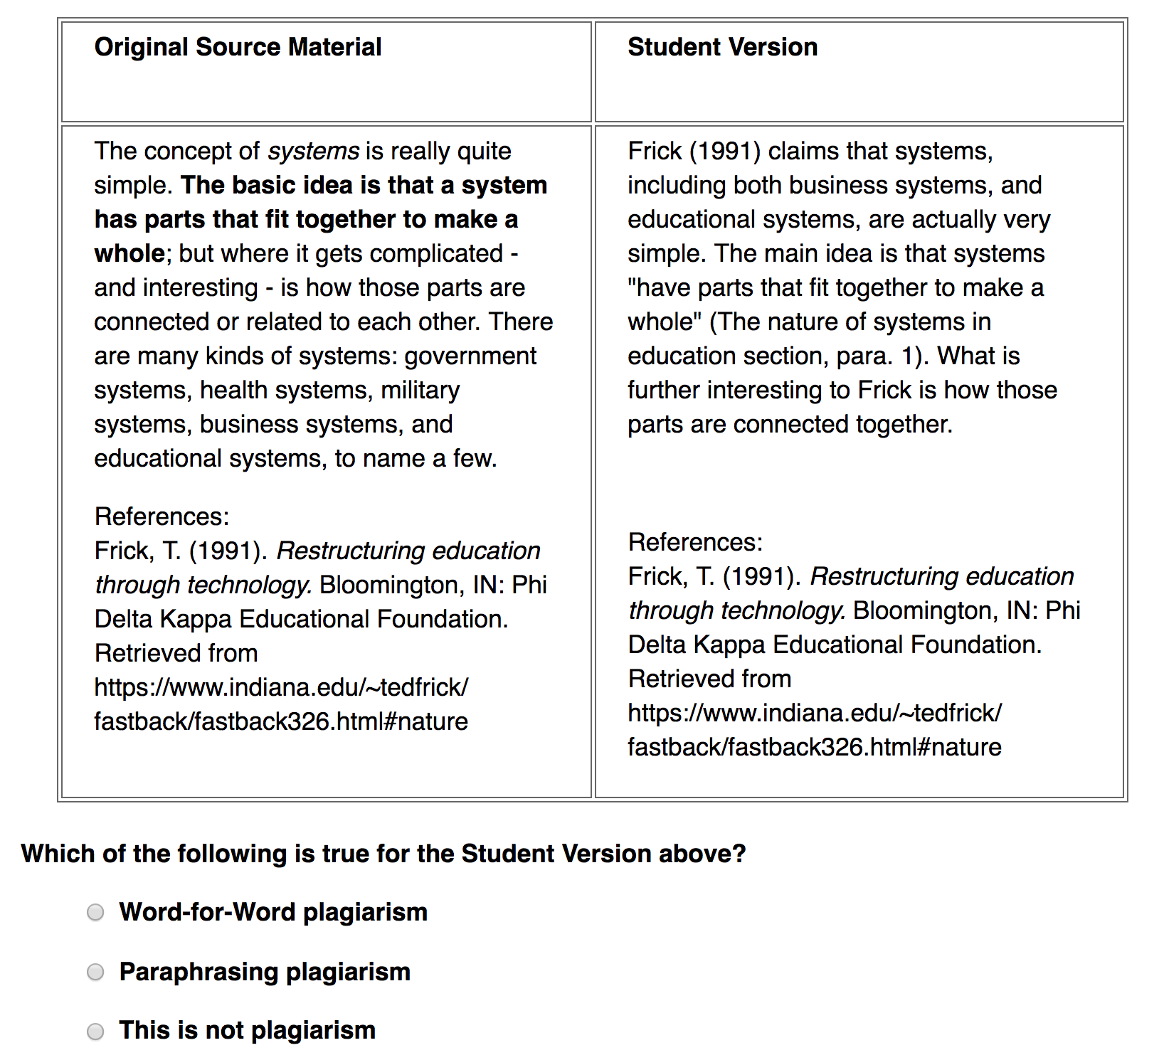
Certification Test (10 randomly selected items from large pool)

Slide 23
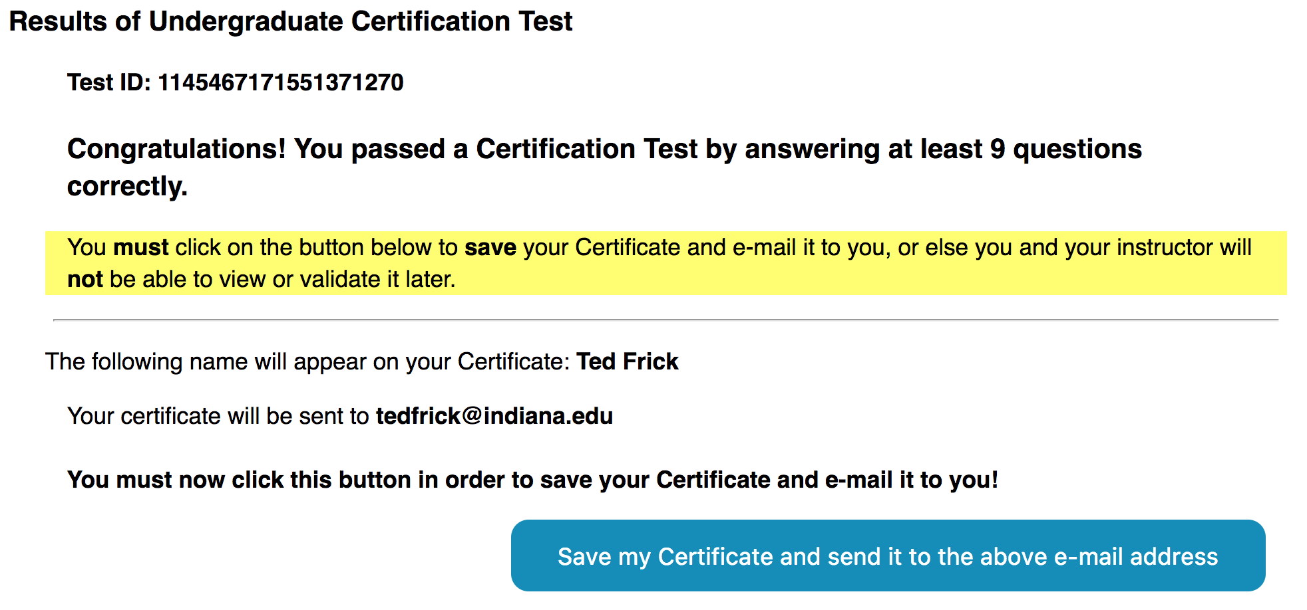
Test Feedback for Pass

Slide 24
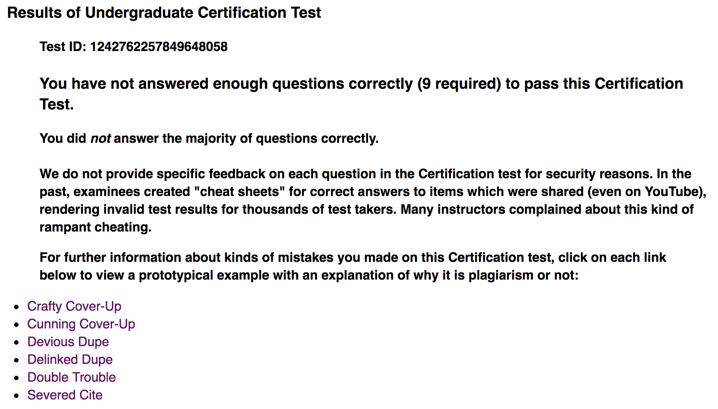
Test Feedback for Fail

Slide 25
Methods

Slide 26
Purpose of Dagli (2017) Study
Investigate the effectiveness of First Principles of Instruction in the context of a mini-MOOC

Slide 27
Problem
Merrill (2002) claimed that the effectiveness of instruction depends upon the extent to which the principles are successfully implemented. Few extant empirical studies have investigated this claim (Merrill, 2013, Chapter 22).
Deficiencies exist with regard to designing, developing, and deploying MOOCs and Mini-MOOCs (Spector, 2014).

Slide 28
IPTAT Data Collection
MOO-TALQ for evaluating instructional quality
  Optional and only used data if user agreed to participate
  Only used results from first MOO-TALQ prior to first test
  Formed scale scores later during data analysis
Certification Test on recognizing plagiarism
  10 questions, randomly selected from a large inventory
  Answer at least 9 out of 10 questions correctly to pass
  40 minutes max. to complete each test
  Only first test attempt was used

Slide 29
ALT: Academic Learning Time
Not just engagement time on relevant learning tasks
Must be successful engagement
Past research on ALT since1970s:
  ALT positively correlated with student learning achievement (e.g., Berliner et al., 1992)
  Frick et al. (2009, 2010) found high correlations of reported ALT in higher ed with First Principles of Instruction
What about First Principles and ALT in MOOCs?

Slide 30
TALQ (40 items) | MOO-TALQ (25 items)
ALT: Academic Learning Time (5) Global course and instructor quality items (3) Learning progress (5) Student satisfaction (4) First Principle: Authentic Problems (5) First Principle: Activation (5) First Principle: Demonstration (5) First Principle: Application (3) First Principle: Integration (5) | ALT: Academic Learning Time (4) Global Course Quality (2) Student satisfaction (2) First Principle: Authentic Problems (3) First Principle: Activation (3) First Principle: Demonstration (5) First Principle: Application (3) First Principle: Integration (3)

Slide 31
Data collection (cont’d)
Data collected Jan. 12 thru Jan. 30, 2016
Imported data for qualified cases into SPSS
Created scale scores for 9 MOO-TALQ scales in SPSS
1716 cases for undergrads and advanced HS students
300 cases for grad students (master’s and doctoral)
Used SPSS Tables procedure for pattern analysis

Slide 32
Findings

Slide 33
Major Results
Undergraduate and advanced high school students:
  Nearly 3 times as likely to pass their first Certification Test who agreed that they experienced First Principles and ALT
  Compared with those who passed their first Test who disagreed that they experienced First Principles and ALT
Graduate students at master’s and doctoral level:
  Over 5 times as likely to pass their first Certification Test who agreed that they experienced First Principles and ALT
  Compared with those who passed their first Test who disagreed that they experienced First Principles and ALT

Slide 34
Next Planned Study of IPTAT

Slide 35
Next IPTAT Study: Analysis of Patterns in Time (APT)
Track actual patterns of usage by creating temporal map for each user
Effectively attempt to replicate Dagli’s study of user reports via MOO-TALQ survey
BUT will actually have empirical trajectories of usage patterns (not just user reports of usage)
Effectiveness of First Principles of Instruction to be determined by APT

Slide 36
Analysis of Patterns in Time (APT)
Need to create version of IPTAT for tracking individual users (temporal maps)
Collect thousands of temporal maps
Then conduct APT queries of maps to determine likelihood of student mastery when First Principles of Instruction are and are not experienced by users
See Myers and Frick (2015) for examples of APT

Slide 37
Summary

Slide 38
Value of MOOCs for Research
Advantages of well-designed MOOCs
  Very large, representative samples
  Broad generalizability
  Relatively easy to replicate over time

Slide 39
Big Data Can Provide Empirical Support for Instructional Theory
IPTAT: Indiana University Plagiarism Tutorials and Tests
IPTAT was redesigned in 2015 using First Principles of Instruction (Merrill, 2013)
IPTAT is a mini-MOOC and used by hundreds of thousands of students (since 2016)
IPTAT results in big data
Big data from IPTAT provide strong empirical support for First Principles of Instruction

Slide 40
Major References
Dagli, C. (2017). Relationships of first principles of instruction and student mastery: A MOOC on how to recognize plagiarism. Bloomington, IN: Doctoral dissertation, Indiana University Graduate School.
Frick, T., Chadha, R., Watson and Zlatkovska, E. (2010). Improving Course Evaluations to Improve Instruction and Complex Learning in Higher Education. Educational Technology Research and Development, 58(2), 115-136.
Frick, T. & Dagli, C. (2016). MOOCs for Research: The Case of the Indiana University Plagiarism Tutorials and Tests. Technology, Knowledge and Learning, 21(2), 255-276, DOI 10.1007/s10758-016-92 88-6.
Frick, T., Dagli, C., Kwon, K., & Tomita, K. (in press, 2017). Indiana University Plagiarism Tutorials and Tests: 14 years of worldwide learning online. Proceedings of the 2016 AECT Summer Research Symposium.
Merrill, M. D. (2013). First principles of instruction: Identifying and designing effective, efficient, and engaging instruction. San Francisco, CA: John Wiley & Sons.
Myers, R. & Frick, T. (2015). Using pattern matching to assess gameplay. In C. S. Loh, Y. Sheng, & D. Infenthaler (Eds.), Serious games analytics: Methodologies for performance measurement, assessment, and improvement, (Chapter 19, pp. 435-458). Heidelberg, Germany: Springer.

